Slide 1
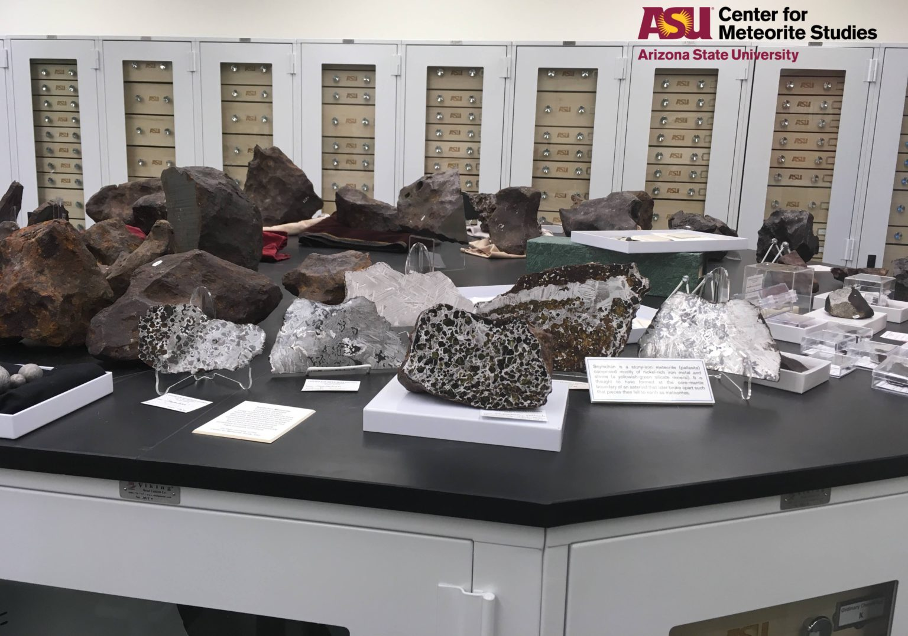
Making Meteorites Accessible
Sam Campbell (They/Them)
Making Meteorites Accessible
Sam Campbell (They/Them)
Notes:
NOTE TO PERSON CHECKING SLIDES: THE BLACK SLIDES ARE INTENTIONAL, NOT VIDEO ERROR

Slide 3
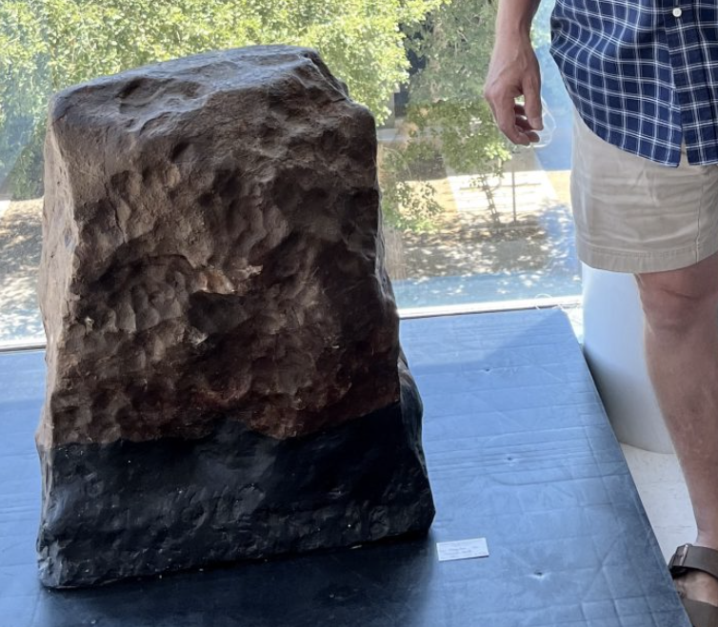
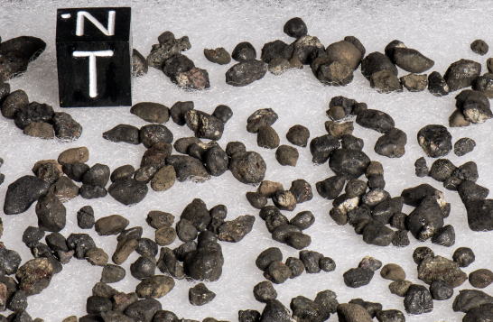
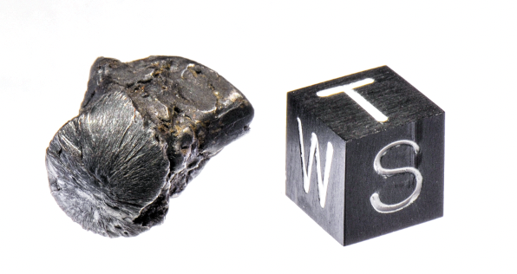
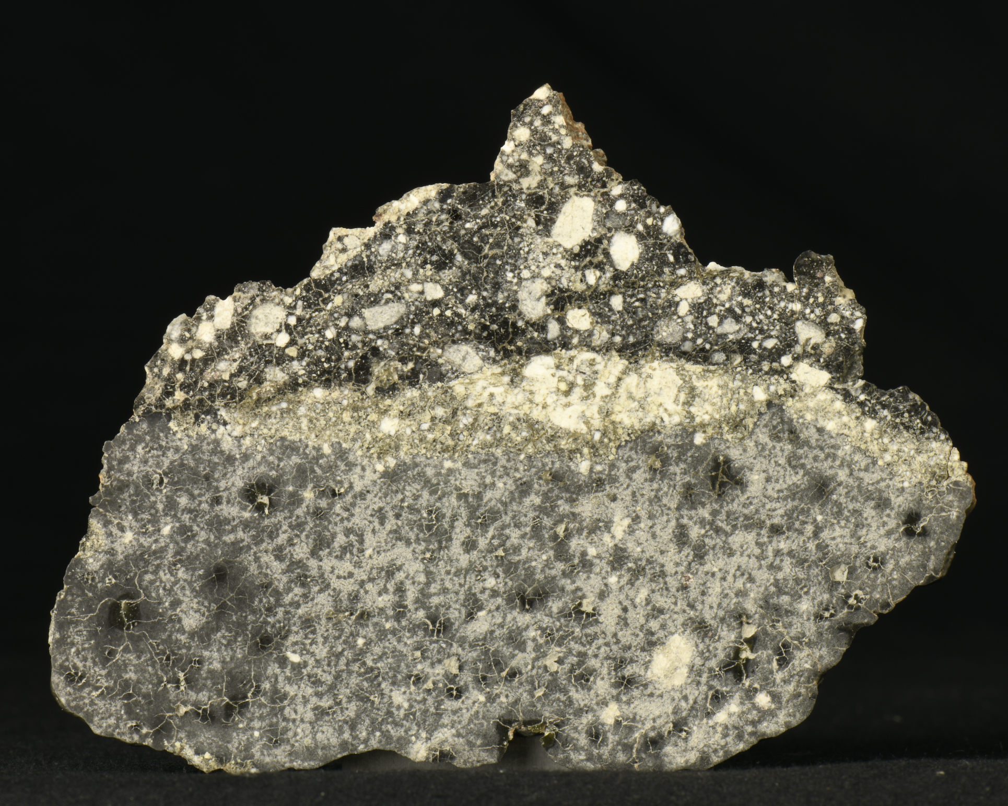
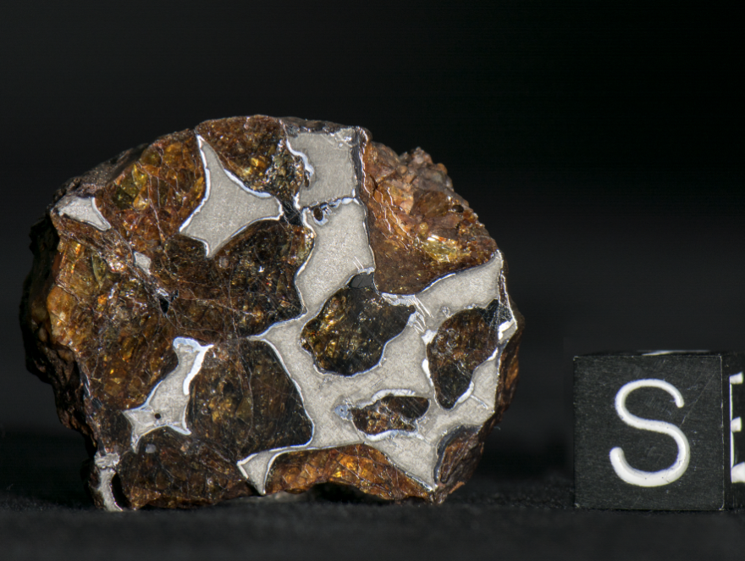
Chelyabinsk
Hugoton
Estherville
NWA 15500 - Lunar
Oued Bourdim

Slide 5
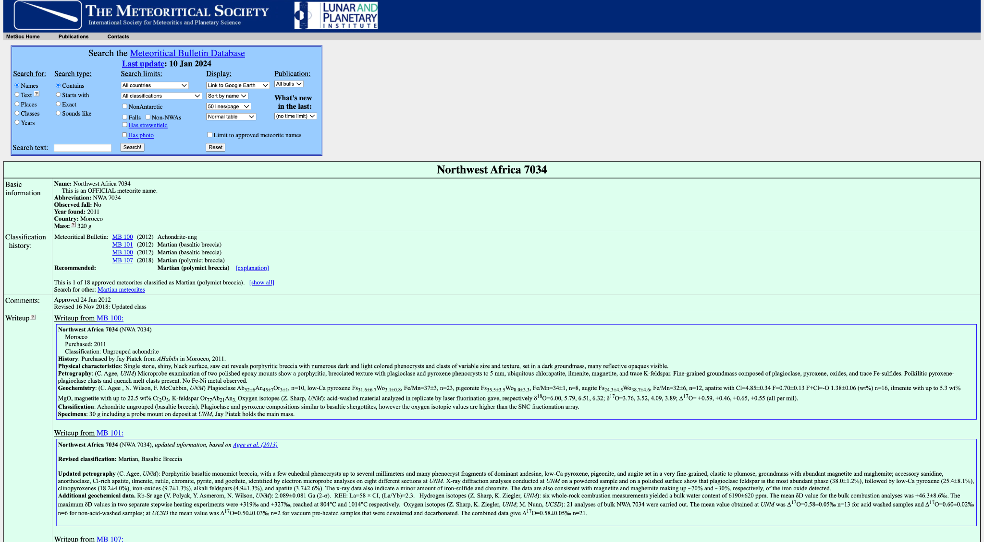

Slide 8
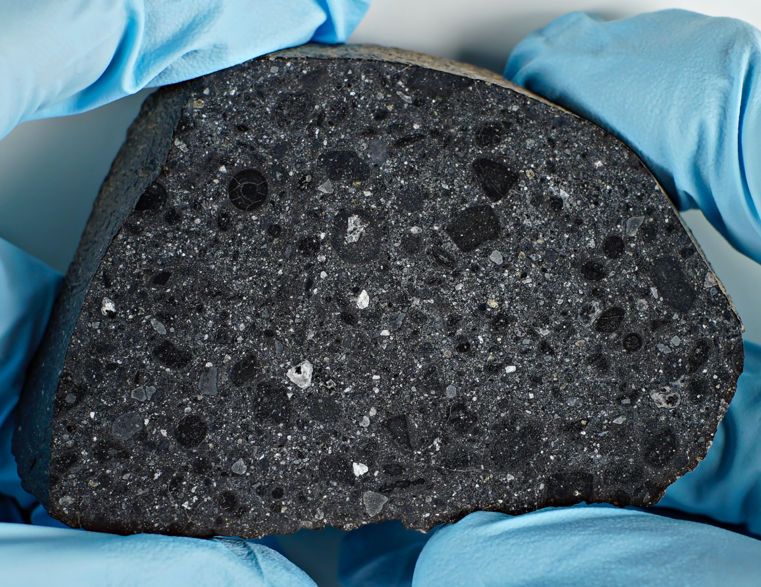
“Porphyritic basaltic monomict breccia, with a few euhedral phenocrysts…”
A rock that has cemented together older pieces of broken up lava rock that contained large chunks of different minerals
A rock that now contains smaller pieces of old rocks and minerals
Notes:
“Porphyritic basaltic monomict breccia, with a few euhedral phenocrysts.
A rock that has cemented together older pieces of broken apart lava rock which contained large chunks of different minerals
A rock that now contains smaller pieces of old rocks and minerals

Slide 10
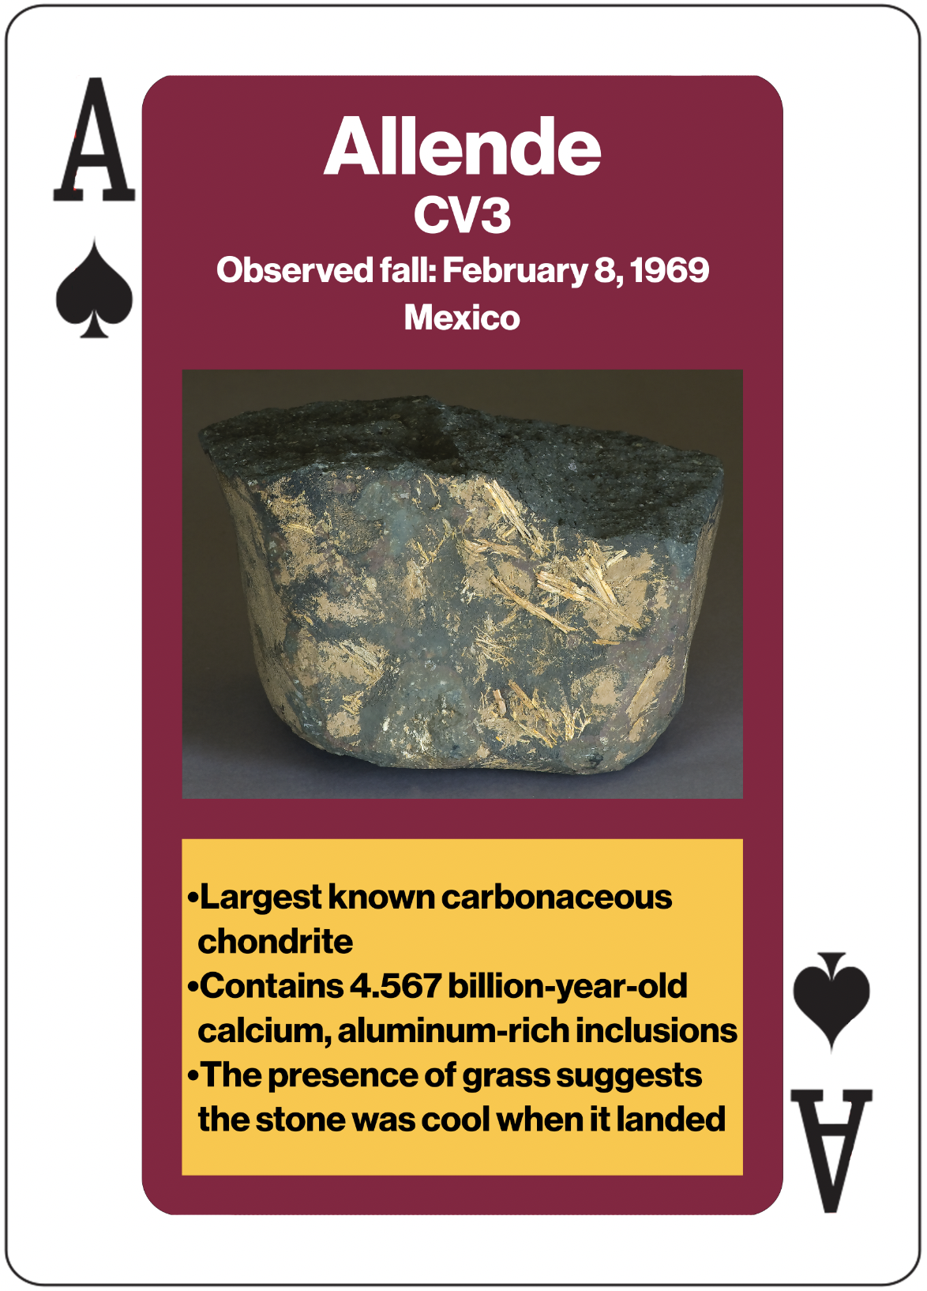

Slide 12
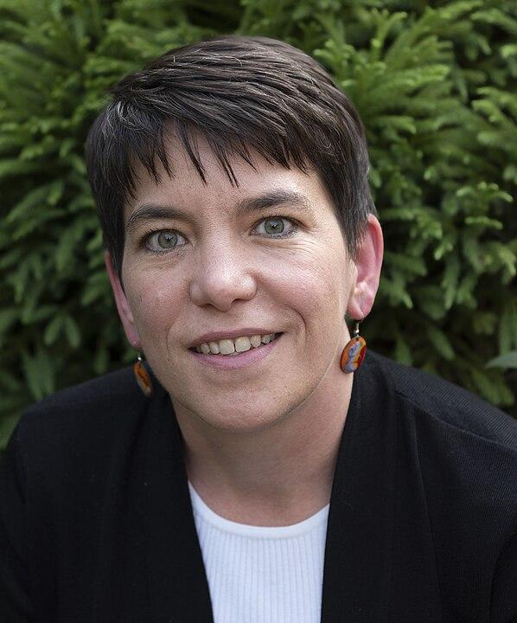
“It fills a basic human need to understand our place in the solar system.
Meteorites are timeless, they help us understand why you and I are here.
I get excited about the little bits of literal stardust I can see through my microscope.
Many of us may have wanted to be an astronaut, but most of us are never leaving this planet,
but all of us can touch a rock from space.”
Notes:
“It fills a basic human need to understand our place in the solar system.
Meteorites are timeless, they help us understand why you and I are here.
I get excited about the little bits of literal star dust I can see though my microscope.
Many of us may have wanted to be an astronaut, but most of us are never leaving this planet,
but all of us can touch a rock from space.”

